Slide 1
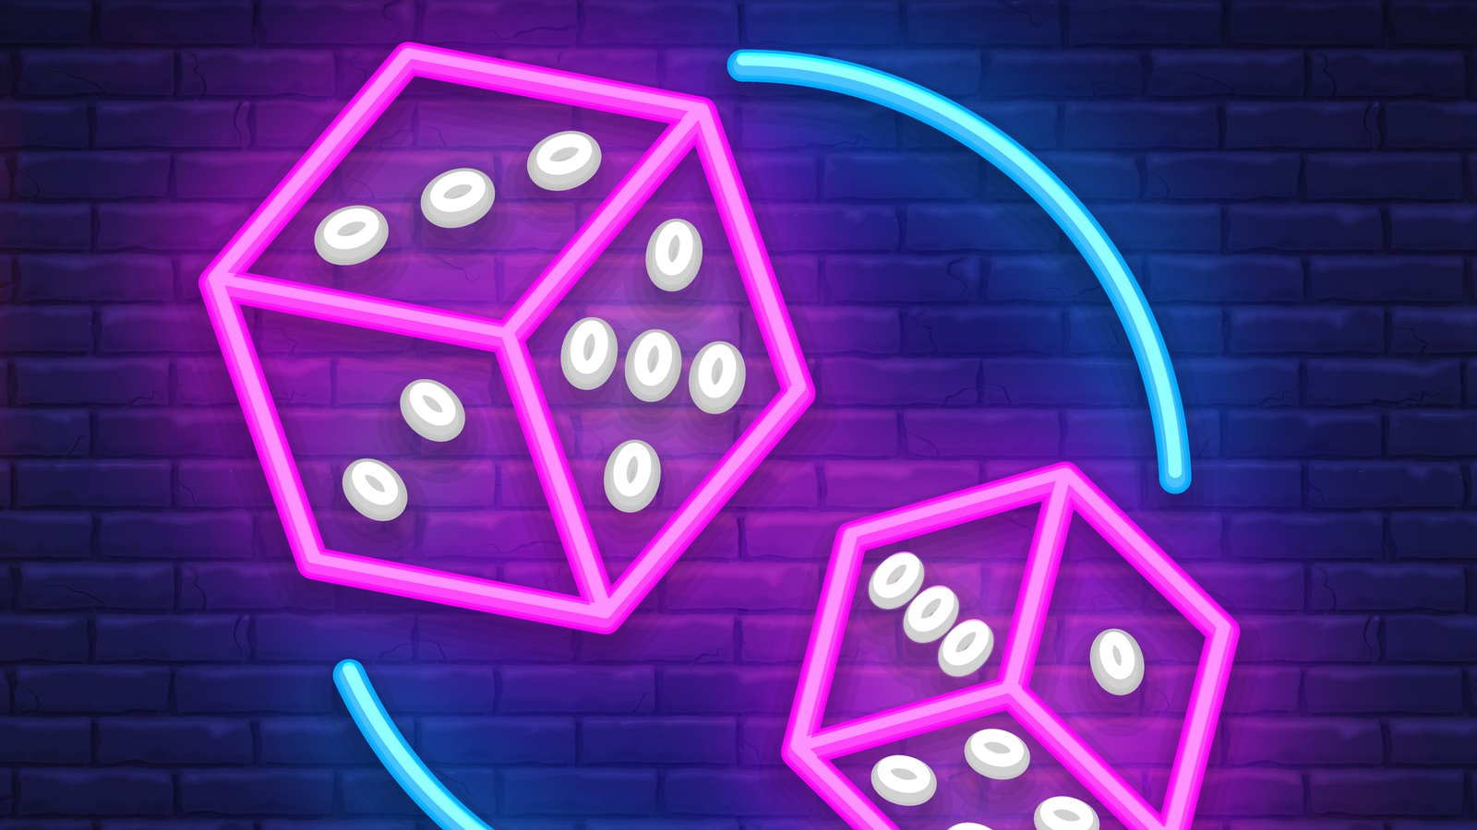
The Dice Game
Gabanella leonardo
Mizzon Alessandro

Slide 2
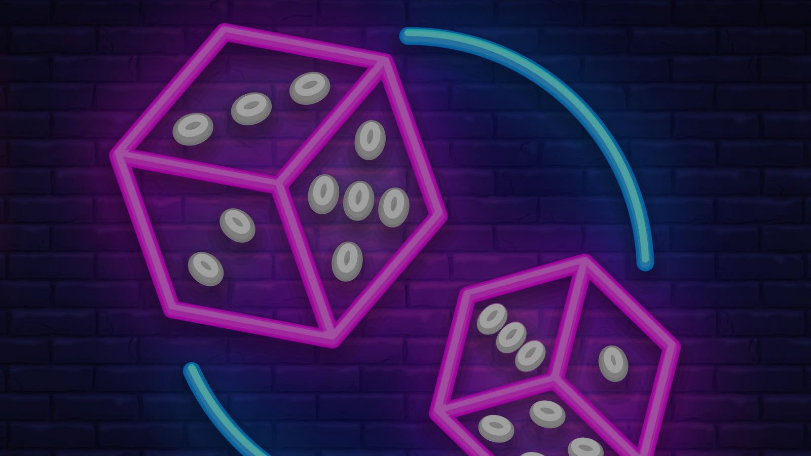
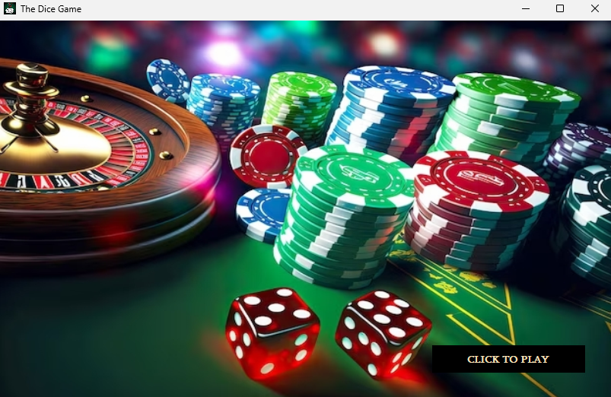
Home screen
To proceed press "CLICK TO PLAY".
The transition from one screen to another during the game is based on changing the visibility of the components.

Slide 3
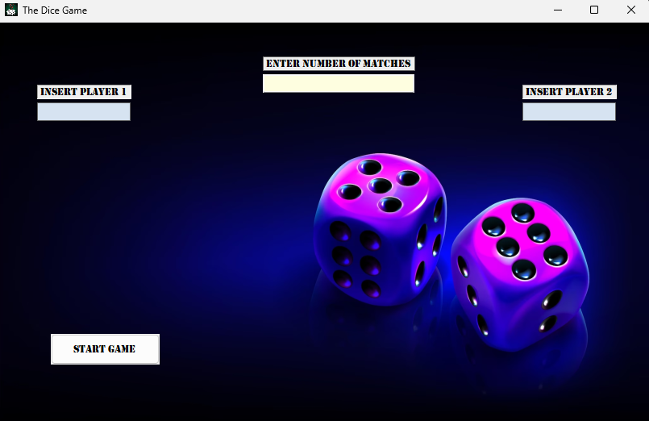
Login screen
Once you have filled in the required fields, click the "START GAME" button to start the game.​
In case you don’t fill all the required fields or insert a wrong value, an error message will appear on the screen.

Slide 4
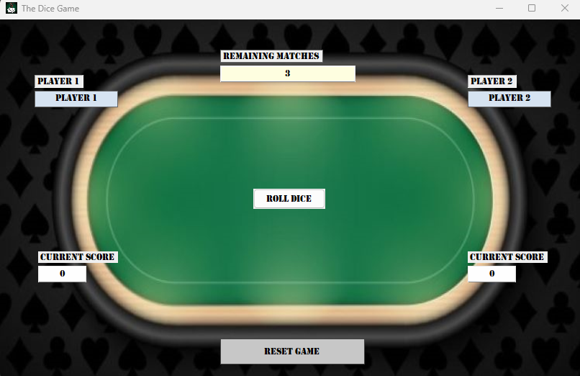
Roll dice
This screen represents the actual game.
Press "ROLL DICE" to throw the players’ dice; the player with the highest dice face obtains a point and in case of the same face one point will be assigned to each player.

Slide 5
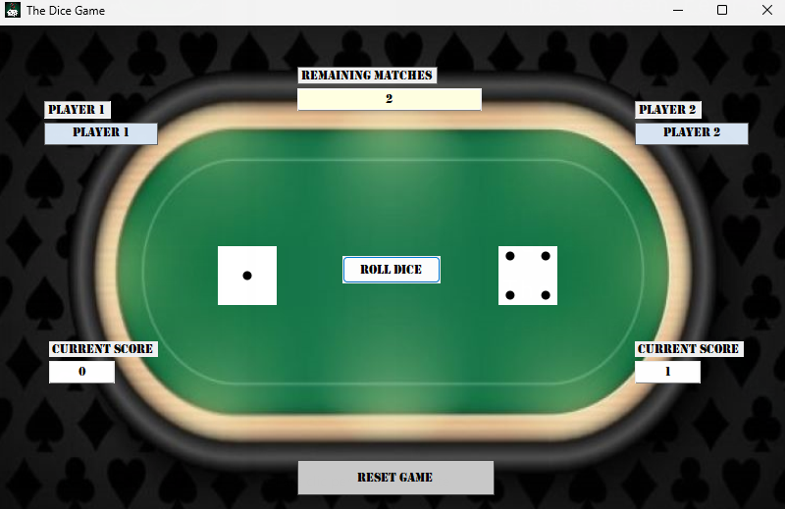
How to reset the game
This button allows to reset the current game, unless it is already finished.

Slide 6
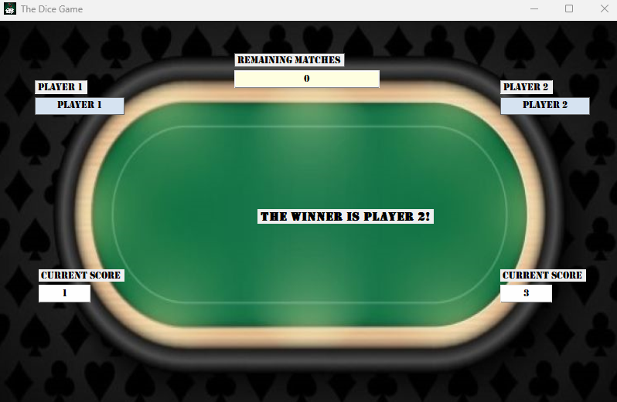
Who is the winner?
When the number of round reaches zero, the player who has won the most number of rouns wins the game; if the players have won the same number of rounds, the message "TIE" will appear on the screen.

Slide 7
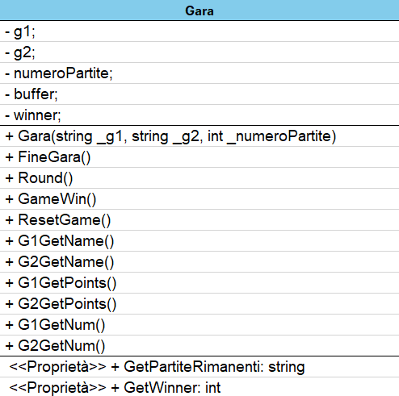
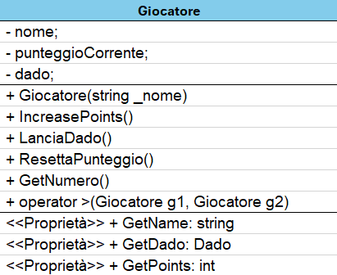
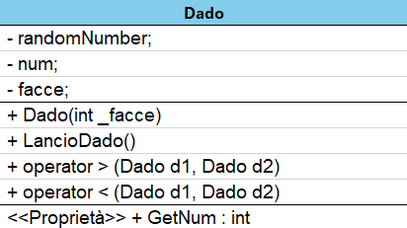
UML diagrams

